Slide 1
Topic 3: Data Visualisation Introduction to Histograms
MM106/BM110
Connor Watret
connor.watret@strath.ac.uk

Slide 2
When to use a bar chart
Histograms are used to visualise characteristics of the distribution of a continuous numerical variable.
These are created by splitting the range of the observed values into evenly sized bins. The number of observations that fall into each bin is then plotted as a bar. This shows where the most observations lie, and give an indication of what the statistical distribution looks like.

Slide 3
Create a histogram of the iris data set
In R the function for creating a histogram is hist(). You simply pass as an argument a vector of observations - commonly the vector passed in is a column of a data frame.
  # create a histogram of the sepal width
  hist(iris$Sepal.Width)

Slide 4
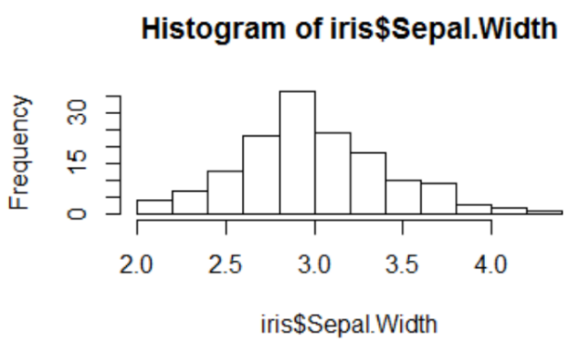
Create a histogram of the iris data set cont...

Slide 5
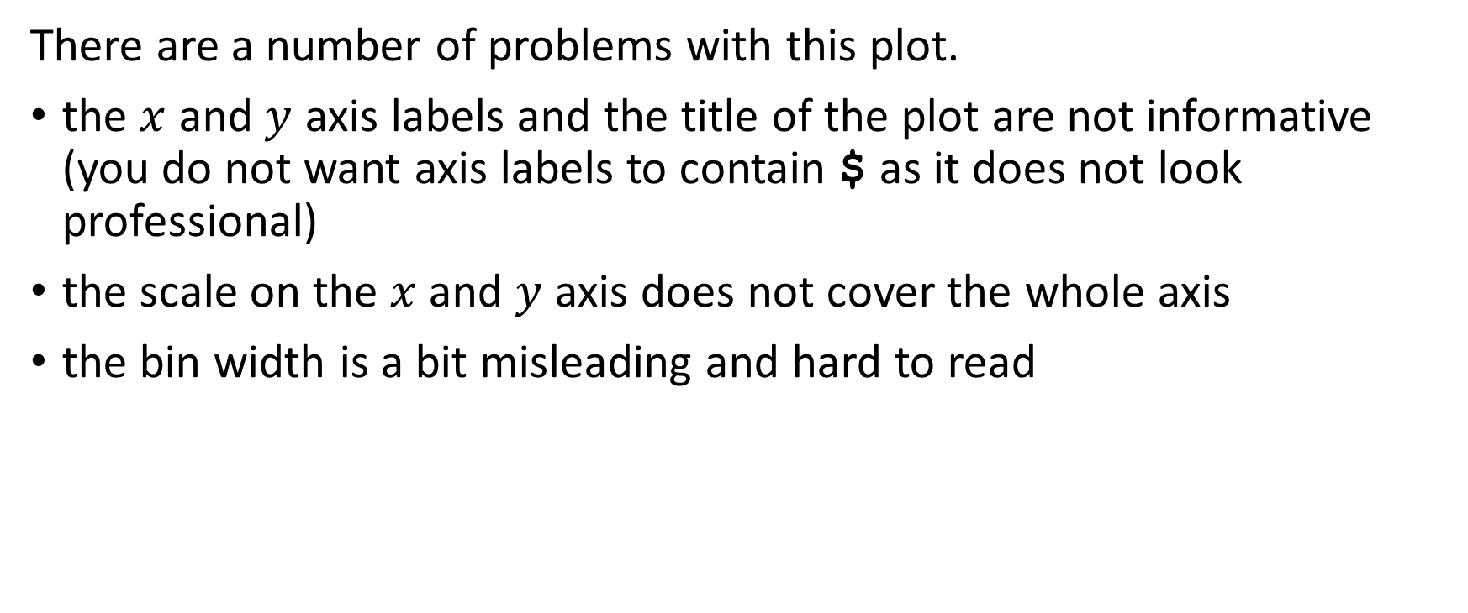
Create a histogram of the iris data set cont...
There are a number of problems with this plot.
the $x$ and $y$ axis labels and the title of the plot are not informative (you do not want axis labels to contain $ as it does not look professional)
the scale on the $x$ and $y$ axis does not cover the whole axis
the bin width is a bit misleading and hard to read

Slide 6
Add axis labels and title to a plot
We have already introduced the xlab and ylab commands in the previous lesson (these functions add informative x and y labels to a plot). We will now introduce the main function which adds a title to a plot.
  #add axis labels and title
  hist(iris$Sepal.Width, xlab="Sepal width (cm)", ylab="Frequency", main="Histogram of sepal width")

Slide 7
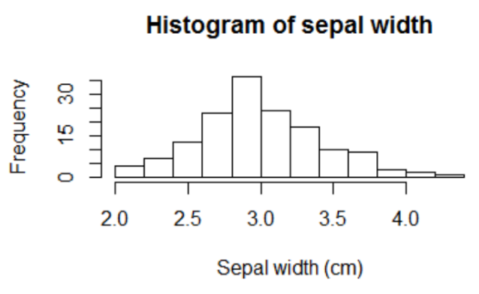
Add axis labels and title to a plot cont...

Slide 8
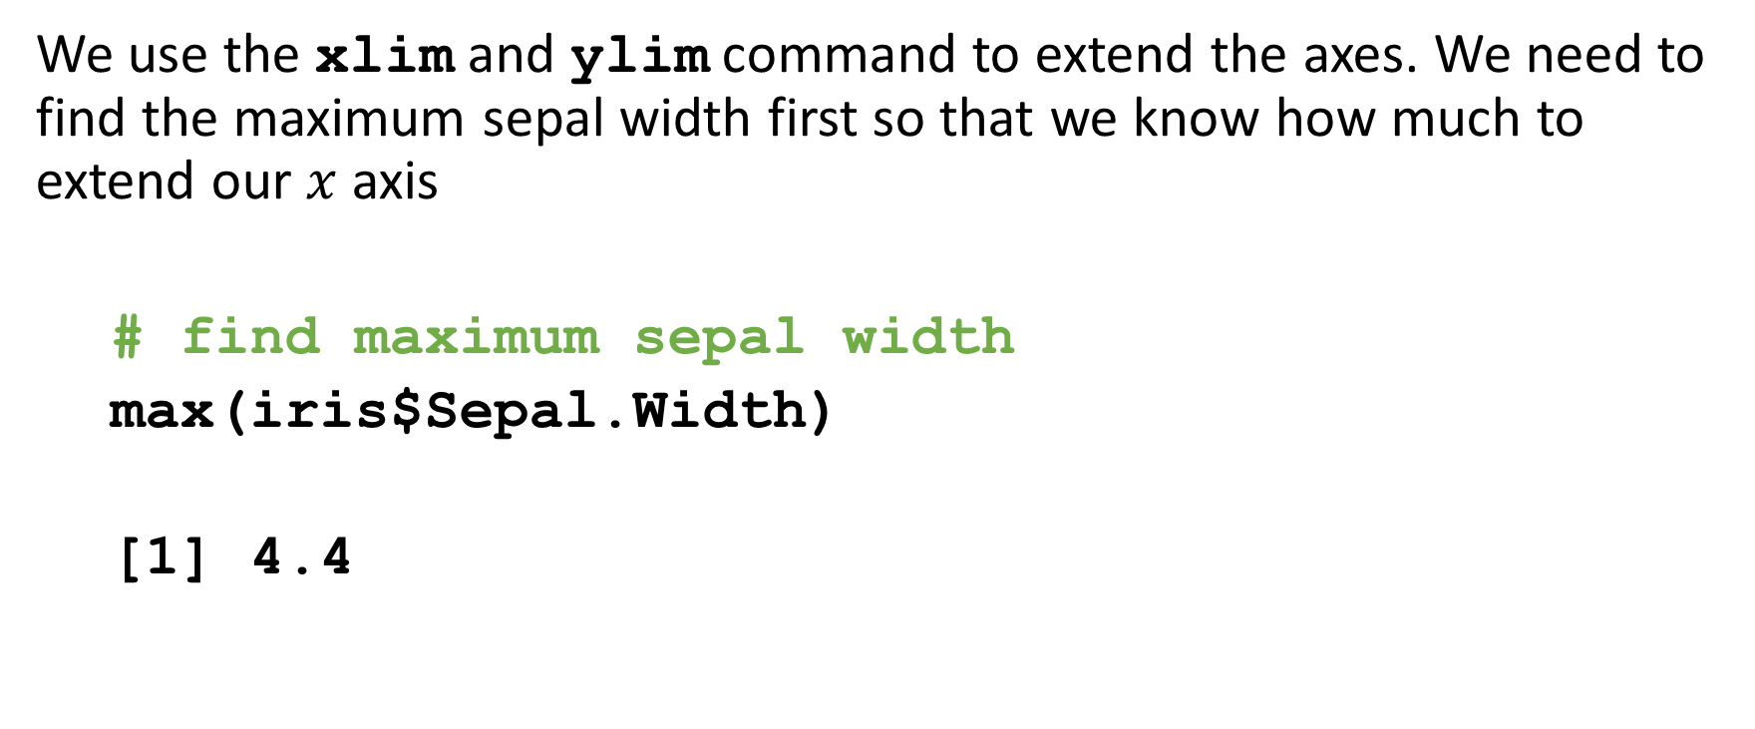

Extending the $x$ and $y$ axis
We use the xlim and ylim command to extend the axes. We need to find the maximum sepal width first so that we know how much to extend our $x$ axis
  # find maximum sepal width
  max(iris$Sepal.Width)
  [1] 4.4

Slide 9

Extending the $x$ and $y$ axis cont...
  hist(iris$Sepal.Width, xlab="Sepal width (cm)", ylab="Frequency", main="Histogram of sepal width", xlim=c(0,5),ylim=c(0,40))

Slide 10
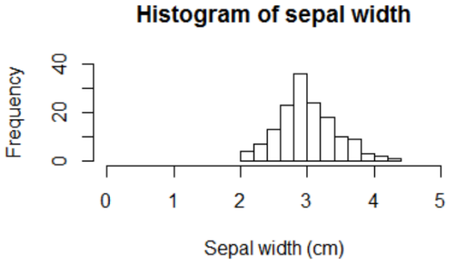
Extending the $x$ and $y$ axis cont...
We can see that there is some bunching in this plot and most of the observations occur between 2 and 4.5.
Let’s adjust the xlim to reflect this.

Slide 11
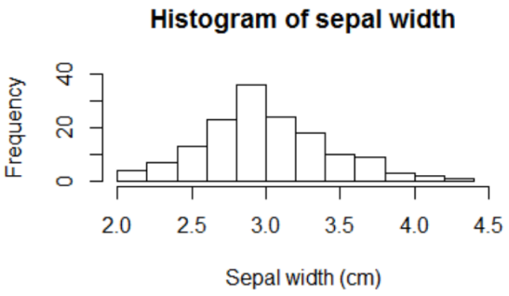
Extending the $x$ and $y$ axis cont...
  hist(iris$Sepal.Width, xlab="Sepal width (cm)", ylab="Frequency", main="Histogram of sepal width", xlim=c(2,4.5),ylim=c(0,40))

Slide 12
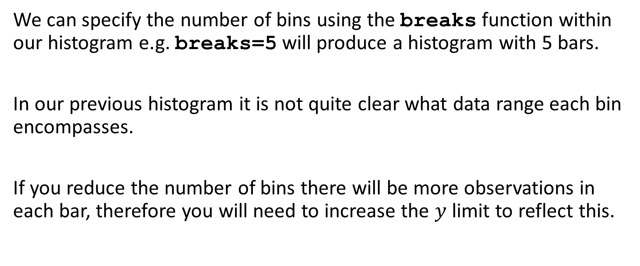
Specifying bin size and number of bins
We can specify the number of bins using the breaks function within our histogram e.g. breaks=5 will produce a histogram with 5 bars.
In our previous histogram it is not quite clear what data range each bin encompasses.
If you reduce the number of bins there will be more observations in each bar, therefore you will need to increase the $y$ limit to reflect this.

Slide 13
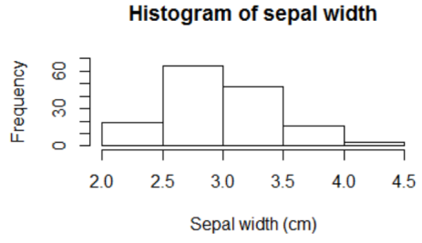
Specifying bin size and number of bins
  hist(iris$Sepal.Width, xlab="Sepal width (cm)", ylab="Frequency", main="Histogram of sepal width", xlim=c(2,4.5),ylim=c(0,70),breaks=5)

Slide 14
Let’s add some colour
The chart is a boring with just white bars, let’s shade those in. R has lots of predefined colours. As mentioned previously, we use the col function e.g. col="light green". This means that all the bars will be light green.
  #colour each bar light green hist(iris$Sepal.Width, xlab="Sepal width (cm)", ylab="Frequency", main="Histogram of sepal width", xlim=c(2,4.5),ylim=c(0,70), breaks=5, col="lightgreen")

Slide 15
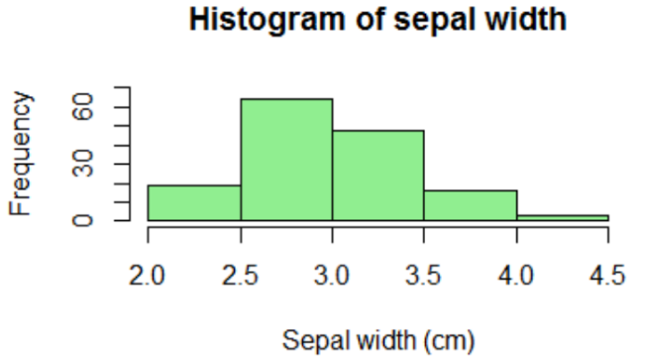
Let’s add some colour cont...

